Slide 2
Water Management / conservation in sugar industry
Water generation, utilization, recycling, and measure to minimize intake water
BY
SYED MUHAMMAD TARIQUE
Deputy General Manager –P
SHARIF KHAN
Assistant General Manager –P
MIRPURKHAS SUGAR MILLS

Slide 3
Abstract
Water is a prime but scarce natural resource, a basic human need and a precious national asset. Therefore, water quality and its management options need to be given greater attention in the developing countries. Industry can well maintain if proper water management activities can be practiced/ and applied in the required area. Calculation of mass and water balance shows that the water content of the cane itself is sufficient for the internal processing of cane sugar. External water ( raw water) is required for cooling crystallizers, mills and turbine cooling water, vacuum pumps, ash collectors, co2 scrubbers, brushing and hydraulic tests etc. By recycling and reuse, the consumption of external water can be minimized hence reduction in cost of fresh water and corresponding reductions in the flow of effluent and expenses of ETP.
In this study I have quantified the volume of condensate water generation, intake water used in sugar manufacturing process followed by the suggestion regarding the re-utilization of the used water. For study the data is collected from previous seasons @ 7000 TCD and Measures for the next season. The paper is prepared completely based on some experience in Mirpurkhas sugar mills and by review of few of related articles.

Slide 4
INTRODUCTION
Fresh Water has now become the most scarce natural resource on the earth and is a significant part of all human activities, from manufacturing to recreation. However, rising water treatment costs, limited fresh water supplies, the need for waste minimization and pollution control issues are compelling industries to take a closer look for increased water usage efficiency, reuse, and conservation.
Sugar industry is a larger water consuming industry . In most sugar-producing countries, water management in sugar factories is a hot issue as the industry is pressed to reduce its water consumption and the emission of pollutants. Water quantity required can vary due to the application of new technology, quality of raw material used , and processing techniques. Generally in Pakistan Not enough water from the process is being conserved, stored and re-utilized. As a result, the industry uses water in large excess. This way of utilizing water is not ethically defendable, not only because of the environmental risks, but also because of the worldwide growing water demand.
Continue…

Slide 5
INTRODUCTION
The aim of the study presented in this report is to perform the water mass balance by calculating the quantity consumed at different processes and stages and evaluate the quality of the excess water in the sugar mills and identify the possibility of using the excess condensate as replacement of raw water in the sugar manufacturing process and reusing / recycling the presently drained raw water to reduce intake raw water. Industry can be well maintained if proper water management activities can practice and applied in the required area.
A summary of the circuits, giving approximate water flow rates, input and output temperatures, water sources and sinks, detailed conservation balances for different alternatives are given in coming slides.
Purpose of water conservation is for saving precious national asset, to save money and to reduce noxious waste discharge that causes environmental pollution. In coming slides it is shortly briefed what type of waste is generated from sugar plant at different process stages and how it effect the environment.

Slide 6
WASTE WATER GENERATION
Input | Unit/House | Waste water Generated
Sugar Cane | Mil House | Waste water from bearing of mills, washing of floors, Baggasse, contains suspended solids and oil/grease s
Sugar Juice | Process house(Juice heaters/ Evaporators/ Condensers/Pans Crystallizers/P.F filters) | Washing of different components such as juice clarifiers evaporators, and water circulation/over flow through condensers. Usage of cleaning and process chemicals. Occasional Spills & Leakages. generates aggressive effluents with high BOD5, COD and TDS concentrations.
Bagasse and Furnace oil | Boiler house | Waste water from scrubbers/blow down of boiler /flay ash particles, smoke , flue gasses. High TDS and phosphates

Slide 7
WASTE WATER COMPOSITION IN DIFFERENT SECTIONS
The sugar industry waste water is characterized by its color, temperature low pH, ash, dissolved organic and inorganic matter of which 50% may present as reducing sugar. It carries the constituents such as Biochemical Oxygen demand, Chemical Oxygen demand, oil and grease in the range which is more than the EPA standards.
Table: Cumulative Waste water analysis sugar Industries Average and MSM result.
Parameters (mg/l) | Mill | Process | Final | MSM Final Results | NEQS Limts
pH | 5.8-6.9 | 7.2- 7.8 | 7.39 | 7-8 | 6-9
TSS | 760-800 | 150-250 | 550-650 | 150-250 | 200
Volatile SS | 173-1500 | 150-2000 | 200-1800 | -
BODs | --- | 350-2800 | 350-3000 | 100-250 | 80
COD | --- | 1000-4000 | 1000-4300 | 300-800 | 150
Oil & Grease | 48-80 | --- | 50-100 | 12-25 | 10 ppm
Kjeldahl nitrogen (TKN) | --- | --- | 15 - 40 | 12-25
Color | grayish | brownish |  | Light gray | Colorless
Temperature C | 35-42 | 40-48 | 43-46 | 40-50
Smell | --- | --- | cane- juice like | Not pleasant.

Slide 8
ENVIRONMENTAL IMPACTS OF EFFLUENTS FROM SUGAR MILLS
PH: Industrial effluents generally change the natural pH level of the receiving water body to some extent. Such changes can tip the ecological balance of the aquatic system, excessive acidity particularly, can result in the release of hydrogen sulfide to the air.
Suspended solids; TSS: TSS reduce light penetration and, as a result, plant production in the receiving water body by increasing turbidity and can also clog fish gills. Benthic decomposition of components can decrease oxygen availability while anaerobic decomposition can produce hydrogen sulfide and release by-products that increase BOD.
BOD: Wastewater from sugar mills with its high BOD rapidly depletes available oxygen supply when discharged into water bodies endangering fish and other aquatic life. The high BOD also creates septic conditions, generating foul-smelling hydrogen sulfide, which in turn can precipitate iron and any dissolved salts, turning the water black and highly toxic for aquatic life.
COD: A measure of the inorganic and partly organic non-biodegradable content of the effluents, has effects on the receiving water body similar to that of a high BOD.
Continue…

Slide 9
ENVIRONMENTAL IMPACTS OF EFFLUENTS FROM SUGAR MILLS
Total Dissolved Solids (TDS): Refers to all dissolved materials present in the water. Combined sugar mill effluents generally do not have a TDS measure high enough to have an adverse environmental impact. Discharge of water with a high TDS level would have adverse impact on aquatic life, render the receiving water unfit for drinking, reduce crop yields if used for irrigation, and exacerbate corrosion in water systems and pipe. (ETPI, 2001).
Highly colored water: Besides being aesthetically unpleasing, limits light penetration, reducing production of phytoplankton and, by association, zooplankton, fish and dissolved oxygen supply.
TEMPERATURE: Effluents with a high temperature can be of concern if discharged to a small or confined water body causing a significant increase above the ambient temperature range or if the warm water attracts fish causing them to be affected by other components of the discharge. High temperatures also deplete dissolved oxygen levels in the water body.

Slide 10
FACTORY WATER BALANCE
In cane sugar factories, utilized water in the process can be obtained from two sources:
1. Water comes along with sugarcane. Internal Water: The internal water , the water from the cane itself which is recovered with different operations within the process (eg. evaporation, crystallization, refinery, etc.) is used for mill imbibitions ,de-sweetening , purging and movement water at pans which is directly involved in the sugar manufacturing process.
2.Water comes from outside such as river, canals, well, dam bore well etc. (External Water /Raw Water) : It does not generally come in contact with the sugar manufacturing process directly. It is used for condensing , cooling power turbines, mill turbines, mill bearings, Raw Mass cooling, air compressors, vacuum pumps, floor washing, vessel washing and domestic use.

Slide 11
Major water flow in a sugar mill.

Slide 12
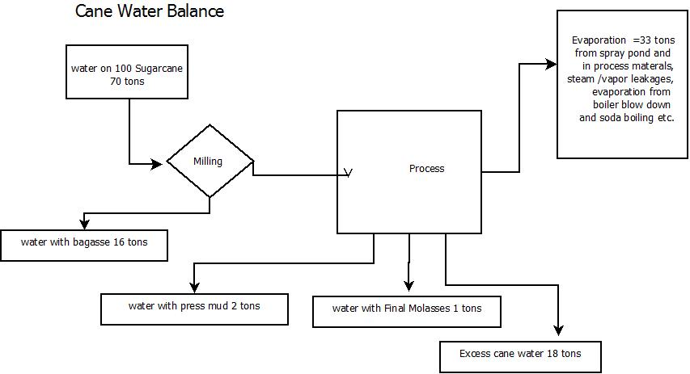
SUGAR CANE WATER BALANCE

Slide 13
Table: Sugar Cane water balance of MSM @ 7000 tcd
S.# | Water In |  |  | Water Out
 | Source | Quantity (Tons) | % on Cane | Source | Quantity (Tons) | % on Cane
 | Cane | 4900 | 70
1 |  |  |  | Evaporation through spray pond | 1,890 | 25-28
2 |  |  |  | Water in bagasse | 1,120 | 16
3
4 |  |  |  | Water in Boiler Ash | 35 | 0.5
5 |  |  |  | Water in Mud | 140 | 2
6 |  |  |  | Evaporation from juice flash tank | 84 | 1.2
7 |  |  |  | Evaporation from Boiler Blow down. | 70 | 1.00
8 |  |  |  | Evaporation through steam leakage | 42 | 0.60
9 |  |  |  | Evaporation through soda boiling | 56 | 0.8
10 |  |  |  | Evaporation at Mills | 56 | 0.8
11 |  |  |  | Evaporation through NCG Steam | 42 | 0.6
Continue…

Slide 14
Tble: Sugar Cane water balance of MSM @ 7000 tcd
12 |  |  |  | Evaporation from Material storage tank | 35 | 0.50
13 |  |  |  | Water in F. Molasses | 70 | 1
14 |  |  |  | Evaporation from Sugar Dryer | 11 | 0.16
15 |  |  |  | Water in Sugar | 0.5 | 0.01
 |  |  |  | Total Water out in Evaporation and Product/by Product | 3651.50 | 52.16
 | Canal | 4,912 | 70.17 | Effluent Water To Drain (Factory municipal effluent is included) | 6160.50 | 88
 | Total Water In | 9812.00 | 140.17 | Total Water Out (Evaporation + Products + Drainage) | 9812.00 | 140.17

Slide 15
SUGAR CANE WATER BALANCE
Here you may notice the water balance of sugar cane. Since Sugar cane contain about 70 % of water. After milling process 16 % is retained with bagasse. Remaining water comes with juice for further processing in Process House, Together with the products of the factory, about 2 and 1 % leaves with mud and final molasses respectively. About one and half % flash out from heated juice , approximate 2 % lost during boiler blow down. Leakages , NCG and other losses counted about 2 % . water goes out with soda boiling is about 1% . evaporation from boiler, boiler ash , and milling about 2.5 % . evaporation from liquid material storage tanks , drift losses, sugar dryers, refined sugar etc. about 1.5%
Major portion about 27 % evaporates from spray pond/ cooling towers.
Hence total 52 % evaporation on cane occurs at different stations including water that exists in product and by product. consequently about 18% water is surplus in the form of condensate. That may be consumed or recycled for many other purpose that can be substitute of intake raw water and eventually causes reduction in final effluent.

Slide 16
MSM CONDENSATE WATER GENRATION AND UTILIZATION BEFORE ADDITION OF PLATE TYPE HEATER FOR CONDENSATE Year 2014-15

Slide 17
MSM CONDENSATE WATER GENRATION AND UTILIZATION BEFORE ADDITION OF PLATE TYP HEATER FOR CONDENSATE
Here is the sketch showing major condensate water production @ 7000 TCD and its utilization in different process stages.
Total condensate water generation @ 7000 TCD is about 400 Tons per hour.
Exhaust steam condensate along with some portion of 1st effect about 142 tons/ hr condensate is returned back to boiler as feed water .
Other major utilization is , water for Massecuite purging, pan movement water, water for lime and chemical solution preparations.
Other main condensate water usage is for de-sweetening at v. filters mud, raw sugar remelting and for pressure filter washing.
Before 2015-16 , we did not have Plate type heat exchanger and tubular heater for condensate hence bulk quantity of excess condensate water went to drain that increased raw water consumption at mill house and effluent load at the end.

Slide 18
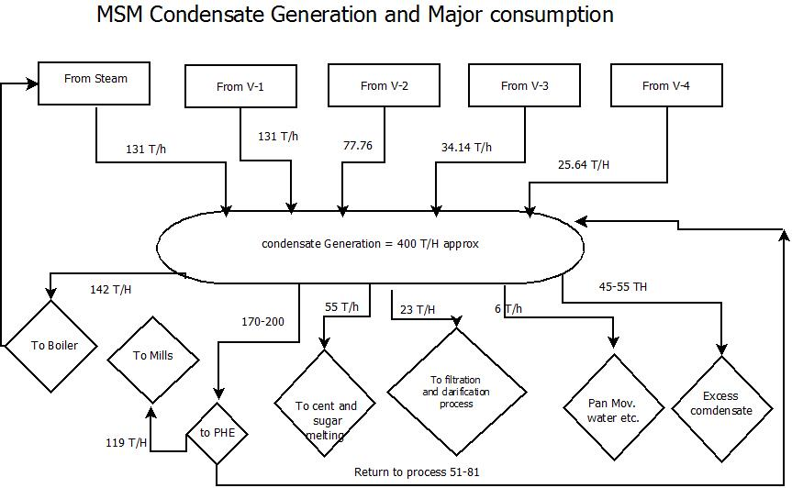
CONDENSATE GNERATION AND USAGE (after addition of PHE) Year 2015-16
Since cane consists of about 70 % water, cane sugar mill processes more water than sugar. All the water entering a mill must also leave it in one form or another.
The overall water mass balance shows that the amount of water coming with the cane is almost enough to maintain the operation of the factory.

Slide 19
CONDENSATE WATER GENERATION AND CONSUMPTION WITH TWO PLATE HEAT EXCAHNGER
This condensate water balance is on 7000 TCD @ 45 % steam , which is average crushing capacity and steam consumption of mirpurkhas sugar mills.
Total condensate water generation @ 7000 TCD is about 400 Tons per hour.
Exhaust steam condensate along with some portion of 1st effect about 142 tons/ hr condensate is returned back to boiler as feed water .
Other major utilization is , water for Massecuite purging, pan movement water, de-sweetening at v. filters mud, raw sugar remelting and for pressure filter washing. water for lime and chemical solution preparations.
Mixed hot water from Over flow of over head hot water tank is collected and passed through plate type heater to heat raw juice than it is utilized for imbibitions and other purpose.
Before installation of plate type heat exchanger, raw water was added for imbibitions to maintain temperature , hence raw water consumption was on higher side with loss of precious condensate water.

Slide 20
Quantification and Distribution of original intake water. Year 2014-15
S NO | Equipment | Ton/day | water in C* Avr. | water Out C* Av | water source make up | qaulity of water | Recycle/drain
1 | feeding Table oil cooler | 116 | 25 | 35 | canal water | good | Drain
2 | Fibrizer gear oil cooler | 30 | 25 | 36 | canal water | good | partially recycled
3 | Fibrizer Turbine oil cooler | 79 | 25 | 36 | canal water | good | partially recycled
4 | Mill House Turbines | 396 | 25 | 36 | canal water | good | partially recycled
5 | Mill house Bearing In side | 170 | 25 | 36 | canal water | good | partially recycled
6 | Mill Bagasse Washing/cooling | 550 | 25 | 36 | canal water | good | Drain
7 | Mills Gearing cooling | 350 | 25 | 36 | canal water | good | partially recycled
8 | Mill House Imbibition tank | 400 | 38 | sink | canal water | good | Drain
9 | Accumulator condenser | 9 | 25 | 35 | canal water | good | chanal
10 | Power House Turbines | 250 | 25 | 36 | canal water | good | partially recycled
11 | Laboratory | 20 | 25 | sinks | canal water | good | Drain
12 | to near by villagers | 20 | 25 | sinks | canal water | good | sinks
13 | Contractors Rooms | 15 | 25 | drain | canal water | good | Drain
14 | Evap Brushing | 63 | 25 | drain | canal water | good | Drain
Continue…

Slide 21
Quantification and Distribution of original intake water. Year 2014-15
S NO | Equipment | Ton/day | water in C* Avr. | water Out C* Av | water source make up | qaulity of water | Recycle/drain
15 | Evaporator shell testing | 35 | 25 | injection chanel | canal water | good | Drain
16 | Calandria hydraulic | 28 | 25 | injection chanel | canal water | good | Drain
17 | Heater Brushing | 38 | 25 | drain | canal water | good | Drain
18 | Co2 Scrubber for carbonation | 500 | 25 | 42 | canal water | good | Drain
19 | Compressor | 37 | 25 | 38 | canal water | good | Drain
20 | Poly Electrolyte | 12 | 25 | sink | canal water | good | processed
21 | Phosphoric & Acco flock | 6 | 25 | sink | canal water | good | processed
22 | CO2 Pumps | 216 | 25 | 38 | canal water | good | Drain
23 | Barometer condenser | 312 | 25 | 40 | canal water | good | Drain
24 | Vacuum Pumps/v.filter | 158 | 25 | 38 | canal water | good | Drain
25 | A conti: Vacuum Pumps | 140 | 25 | 40 | canal water | good | Drain
26 | Vertical Cryast: | 873 | 27 | 38 | canal water | good | imbibition/ injection pit
27 | Total tap water , bathing, canteen, gardining, car wash, | 88 | 25 | sink/drain | canal water
 | Total water per day | 4912

Slide 22
QAUNTIFICATION OF RAW / INTAKE WATER @ 7000 TCD FOR MSM. Year 2014-15
A water audit was carried out at mirpukhas sugar mills to monitor how much quantity of Raw water is being used at different stations.
For this flow meter were installed at intake water and in coming season going to install at out flow .
Water measured at different process section for its consumptions.
You may see all detail in this table.
Major water consumption was observed at cooling C and B-massecuite in vertical crystallizers, make up water for imbibitions at mill house, carbonation CO2 scrubbers, refrigeration at different cooling units like mills gearing, mill and power turbines and vacuum pumps.
Total intake raw water was about 4912 M3/ day
Imbibition water : The first large water requirement is the imbibition water required for washing the sugar out of the crushed cane. Most mills require that this water be applied cold for various reasons. The main reason is to prevent roller slip when large quantities of imbibition water are used on mills operating at high fiber throughputs, Therefore to maintain required temperature of 50-55 C, raw water was added with condensate / hot water for imbibition. That was about 1400 M3 / day.
Continue…

Slide 23
QAUNTIFICATION OF RAW / INTAKE WATER @ 7000 TCD FOR MSM AT MAJOR STATIONS. Year 2014-15
The Power and mills turbines & gearing cooling system. A good quantity and good quality of raw water is used for cooling in the cooling system of mills & power turbines and Gearings. Before comprehensive cooling arrangements it was Partially circulated raw water. That is about 1250 M3/day.
low grade crystallizer cooling system: Cold water is required for massecuite crystallizer cooling. It is normally the 3rd largest water load. We have five vertical crystallizers , 4 batch crystallizers, used a closed circuit system fed by fresh water. . The system used 'once through' fresh water, was delivering into the injection water circuit and some portion for imbibitions.
CO2 scrubber for carbonation: In carbonation refinery a huge amount of raw water is used as it was in Mirpurkhas sugar mills about 600 M3 /day.
Cooling and sealing water on vacuum pumps and compressors. cold water is required for vacuum pumps and compressors, that was about 500 M3/day
BAROMETRIC CONDENSER: For barometric condenser of v. filters raw water was used 312M3/day.

Slide 24
Quantification and Distribution of intake water After Recycling and Reuse. Year 2015-16
S NO | Equipment | Ton/day | water in C* Avr. | water Out C* Av | water source make up | qaulity of water | Remarks
1 | feeding Table oil cooler | 0 | 29 | 38 | canal water | good | Recycled 100
2 | Fibrizer gear oil cooler | 0 | 29 | 37 | canal water | good | Recycled 100
3 | Fibrrizer Turbine oil cooler | 0 | 29 | 38 | canal water | good | Recycled 100%
4 | Mill House Turbines | 0 | 29 | 38 | canal water | good | Recycled 100%
5 | Mill house Bearing In side | 0 | 29 | 38 | canal water | good | Recycled 100%
6 | Mill Baggase Washing/cooling | 550 | 29 | 40 | canal water | good | Drain
7 | Mills Gearing cooling | 0 | 29 | 38 | canal water | good | Recycled 100%
8 | Mill House Immbibation tank over flow | 300 | 38 | sink | canal water | good | Drain, this year we are installing auto control loop
9 | Accumulator condenser | 9 | 25 | 35 | canal water | good | chanal
10 | Power House Turbines | 0 | 29 | 38 | canal water | good | Recycled 100%
11 | Laboratory | 20 | 25 | sinks | canal water | good | Drain
12 | to near by villagers | 20 | 25 | sinks | canal water | good | sinks
13 | Contractors Rooms | 15 | 25 | drain | canal water | good | Drain
14 | Evap Brushing | 0 | 40 | drain | canal water | good | 100 % replaced with injection water
Continue…

Slide 25
Quantification and Distribution of intake water After Recycling and Reuse.
S NO | Equipment | Ton/day | water in C* Avr. | water Out C* Av | water source make up | qaulity of water | Remarks
15 | Evaporator shell testing | 0 | 40 | injection chanel | canal water | good | 100 % replaced with injection water
16 | Calandria hydraulic | 0 | 29 | Recycled | canal water | good | Recycled 100%
17 | Heater Brushing | 0 | 40 | Drain | canal water | good | 100 % replaced with injection water
18 | Co2 Scrubber for carbonation | 0 | 30 | 44 | From v.cryst | good | Drain, next year will be used at stack scrubber
19 | Compressor | 37 | 30 | 40 | canal water | good | Will be recycled in coming season
20 | Poly Electrolyte | 12 | 25 | Sink | canal water | good | process
21 | Phosphoric & floatation aid | 6 | 25 | Sink | canal water | good | process
22 | CO2 Pumps | 216 | 30 | 40 | canal water | good | Drain
23 | Barometer condenser | 0 | 40 | 46 | canal water | good | 100% replaced with injection water
24 | Vacuum Pumps/v.filter | 158 | 30 | 41 | canal water | good | Drain
25 | A conti: Vacuum Pumps | 140 | 30 | 43 | canal water | good | Will be recycled in coming season
26 | Vertical Cryast: | 873 | 29 | 41 | canal water | good | imbibition/ Co 2 scrubber. Will be recycled 100% recycled through cooling cell in upcoming season
27 | Total tap water , bathing, canteen, gardining, car wash, | 65 | 25 | sink/drain | canal water |  | Unnecessary water taps plugged
 | Total water per day | 2421

Slide 26
Quantification and Distribution of intake water After Recycling and Reuse. Year 2015-16
After quantification we observed that Raw water consumption is about 4912 M3 /day. (before recycling and reusing work)
Many steps were taken to reduce it.
Some changing were made in process to reduce intake water.
The once-through technique for Massecuite cooling water demands excessive amount of fresh water and generates excessive effluent overflows. Instead of once through fresh water a closed system with a dedicated cooling tower will be introduced in coming season, with small addition of fresh water due to drift loss or maintaining required temperature. Here a bulk quantity of water will be saved further.
Eliminated Raw water usage where it was possible. (e.g. water-cooled air-compressors were replaced with air-cooled compressors.), these were too old.
To reduce raw water addition at Mills house two plate type heater were added and one 500 M2 condensate tubular heater is going to add this season. The excess hot condensate was used to heat raw juice and the out let water was used for imbibitions. Hence, the consumption of raw water (1400M3) and steam (about 2 tons /hr reduced.
Continue…

Slide 27
Quantification and Distribution of intake water After Recycling and Reuse. Year 2015-16
Raw water for CO2 scrubber/wash waster was replaced by recycling of vertical crystallizers. For coming season cooling tower is to be added to cool and recycle V. cryst used water and water from Vacuum pumps and compressor will be diverted to CO2 scrubber
Mill washing, and external cooling of mills : Raw water was used for external cooling and cleaning : We tried to remove the oil contained in the cooling water by de-oiling equipment / oil skimmer, strainer to separate the bagasse, then the water after treatment in ETP could be used for irrigation, at the moment it is going to drain and than for irrigation.
For barometric condenser of v. filters injection water is used in place of raw water, after removing of vacuum leakage and proper sealing of heads.
The mill brass bearing cooling system. It is subjected to contamination of oil and grease, incase of contamination goes to drain otherwise recycled to raw water circuit.
Continue…

Slide 28
Quantification and Distribution of intake water After Recycling and Reuse. Year 2015-16
The mill turbine / power house turbine bearings cooling system:
Before water conservation work it was partially recycled but now It is mixed with raw water and completely recycled.
Substituting excess hot condensate for fresh water in utility operations such as hosing or manual cleanup by bagasse methods is also used to reduce the need for hosing.
The identification of source and sinks in the sugar process permitted to demonstrate a surplus of water in the process. Alhamdulillah, with some modification, alteration and addition that involved very low cost we succeeded to reduced intake water consumption about 51%.
In coming season, we are going to add cooling cells, tubular condensate heater 500 M2 and rearrangement of some water flow, Insha Allah that will reduce further 30% of intake water from existing figure (2421M3/day) and will touch to 1695 M3 / day.

Slide 29
Comparison of in take water consumption before reduction/recycling vs after reduction /recycling work with target
Continue…

Slide 30
Measures for minimization of intake water and lessen effluent generation:
Vigilant management practices are a key starting point in reducing consumption of Raw water and ultimately substantial reductions in wastewater volume and pollutant load.
Water conservation by:
Prevention or minimization of spills and leaks through regularly inspecting and repairing various units (pumps, conveyors, pipes, and other vessels) because they have an extremely high BOD of around 900,000 mg/l (UN ESCAP, 1982).
Monitoring of quantity of incoming and outgoing water in plant with flow meters, measuring the flow.
Mills should be operated at optimum capacity and with minimum stoppages because raw water consumption per ton of cane crushed increases when crushing lower than the optimum capacity and when hot water production is suspended during halts in operations (cleaning, restocking, and breakdowns).
Continue…

Slide 31
Measures for minimization of intake water and lessen effluent generation:
Using sugar contaminated condensate for maceration at mill house will not compromise the sugar recovery during imbibition process and it is also replaces the use of raw water intake.
Cooling water from mill bearings should be separated from the effluents and the oil content removed using oil skimmers, achieving the recovery of lubricating oil and reduction of soil contamination when the effluents are used for irrigation.
Minimizing the mixing of filter cake with waste water reduces pollutant content
Entrainment can be minimized with the use of efficient entrainment separators and mist eliminators in evaporator and pans changes also made in MSM.
Caustic wastes from the cleaning equipment should be separated from the rest of the wastewater and gradually released into furrows and blended with the other effluents (ETPI, 2001).
Continue…

Slide 32
Measures for minimization of intake water and lessen effluent generation:
Arrangement to divert the lime house via grit chamber to condensate water channel to reclaim both water and residual lime which helps to make up of condensate water p.H
Residue from factory lab should be properly collected and lead to raw juice tank instead of drains.
For better water management some of the small cooling duties to be installed in the factory. Where Used, a little bit hot water can be cooled to reduce the factory need for fresh water. i.e water from air compressor, mills , turbine , vertical crystallizer and vacuum pumps , to be used for cooling duties. (Mijaylova et al. 2009) This arrangement reduces both the factory need for fresh water and its production of effluent.
Continue…

Slide 33
Measures for minimization of intake water and lessen effluent generation:
Juice and maceration water receiving tank overflows should be controlled using level control loops.
Water leakages and cooling water used for pumps should be minimized by installing mechanical seals and proper maintenance of pumps.
Install ETP system such as anaerobic digester/trickling filter + aerobic or SBR (Hampannar & Shivayogimath 2010). For next year MSM has planned to treat waste water through ETP system.
Use injection water for boiler ash quenching in emergency, brushing of juice heater, evaporators and general cleaning.
There are many other useful techniques available in literature for water conservation.
Continue…

Slide 34
CONCLUSION
The main conclusions which could be drawn from the above review are that in sugar cane industry considerable water saving can be achieved by better house keeping, segregating, recycling and reusing of water. There are several initiatives being followed by MSM to minimize their water consumption, However, in addition to this, research to address existing gaps is also necessary to provide a comprehensive and cost effective solution to enable the industries to become low water consuming and zero discharge units.
The target for fresh water requirement is 1500 -2000 m³/day and requirement was successfully lowered achieving a reduction of approximately 51 %. A decrease in net effluent outflow from the process was also observed. The methodology is flexible and can handle large processes.
Due to water shortage, EPA pressure and our ethical and national interest MSM management decided to implement a three year water conservation plane by allocating reasonable budget. In first year we have reduced 51 % intake water, for coming season our target is to reduce further 17 % than we will reach to final consumption of 1500 -2000 M3 / day. And for its treatment we will install ETP system to reduce pollutant load to environment.

Slide 35
ACKNOWLEDGEMENT
Mr. Abdul Waheed Qureshi is gratefully acknowledged for his tutoring and support .
The author would also like to thank Mr. Sharif Khan co-author and Mr. Sanaullah of Mehran Sugar Mills for their collaboration in sharing ideas and the inventory data gathering exercise.
The authors would also like to acknowledge the contributions of Mr. Tahir Bashir Project Head and Mr. Muhamamd Ali GDO, who provided much of the conceptual foundation for water reduction in process

Slide 36
REFERENCES
WATER CONSERVATION IN SUGAR MILLS : By D. J. L. HULETT Deon Hulett ~ n dPa rtners S.A
TOTAL WATER MANAGEMENT , OPERATION AND MAINTENANCE , TROUBLE SHOOTING OF ETP IN SUGAR INDUSTRY: Harush D P1 and Hampannavar U S2
WATER CONSERVATION IN SUGAR INDUSTRY : Baban Gunjal and Aparna Gunjal*
Maharashtra State Agricultural Marketing Board, Pune, India
ANALYSES OF THE VOLUME OF MAIN WATER AND WASTE WATER IN SUGAR MANUFACTURING PROCESS, SUGGESTIONS REGARDING RE-UTILIZATION OF WASTE ATER. Chetan Sharma†* and Vikas Kumar† (Haryana), India
WATRER AND WASTE WATER MANAGEMENT IN A SUGAR PROCESS PRODUCTION. Meilyn González Cortés1*, Harry Verelst2, Rubén Espinosa Pedraja1, Erenio González Suárez1 Cuba.
ENVIRONMENTAL MANAGEMENT IN THE SUGAR INDUSTRY D.B . S APKAL, DEEPALI NIMBALKAR and B .B. GUNJAL Pune
SIMULTENIOUS ENERGY AND WATER MINIMIZATION APPLIED TO SUGAR PROCESS PRODUCITON: Meilyn González Cortés1*, Harry Verelst2, Ruben Espinosa Pedraja1, Erenio González Suárez1 Central University of Las Villas. Santa Clara, Villa Clara, Cuba.
AN APPROACH TO ZERO-EFFLUENT IN CANE SUGAR FACTORIES
W.D. Hsieh, H.K. Sheen & C.H. Chen (TSRI), Tainan
MINIMISING THE EFFLUENT FLOW FROM A CANE SUGAR FACTORY P.G. Wright and K.F. Miller Sugar Research Institute, Mackay, Queensland, Australia.
MILL-WIDE WATER MANAGEMENT IN THE SOUTH AFRICAN SUGAR INDUSTRY A PALAZZO
QUALITY AND MANAGEMENT OF WASTE WATER IN SUGAR INDUSTRY. Pradeep Kumar Poddar • Omprakash Sahu
ALTERNATIVE UTILIZATION OF EXCESS WATER IN CUBAN SUGAR MILLS
INDUSTRIAL POLLUTION CONTROL GUIDELINES (Bangkok: 1982).
POLLUTION PREVENTION AND IN-PLANT CONTROL MEASURES IN SUGAR MILLS – A Guidebook for Technical and Operational Staff (Islamabad: Sustainable Development Policy Institute (SDPI), 1999).

Slide 37
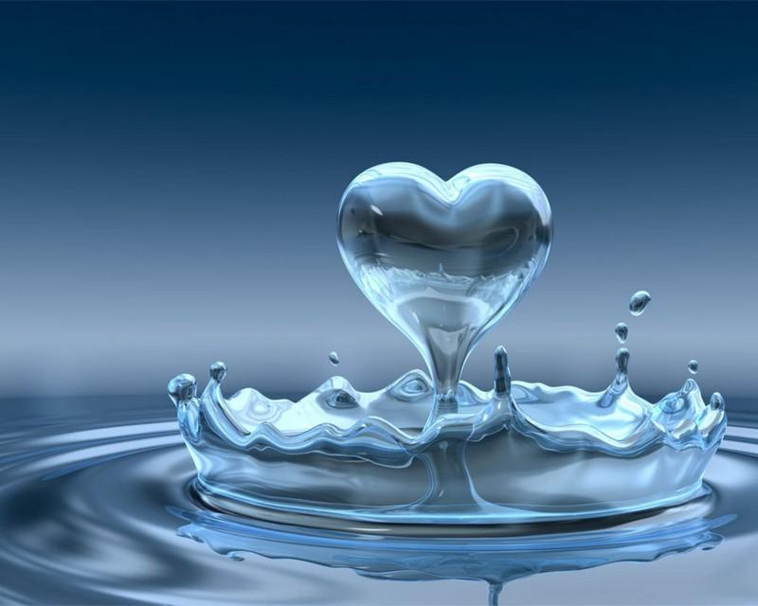
Water is Precious
Save water
Save Money & Life
S.M Tariq & Sharif Khan

